Slide 1
Simple.Data
Prosta biblioteka dostępu do danych
KRZYSZTOF KRZYŚKÓW

Slide 2
What is Simple.Data?
“It’s not an O/RM. It looks a bit like one, but it doesn’t need objects, it doesn’t need a relational database, and it doesn’t need any mapping configuration. So it’s an O/RM without the O or the R or the M. So it’s just a /.”

Slide 3
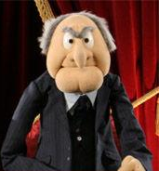
What is Simple.Data?
GitHub
https://github.com/markrendle/Simple.Data
Blog
http://blog.markrendle.net/
Google group
https://groups.google.com/forum/#!forum/simpledata
Mark Rendel

Slide 4
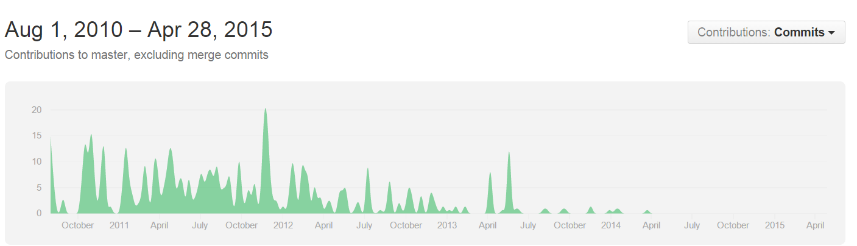
What is Simple.Data?

Slide 5

What is Simple.Data?
ActiveRecord
DataMapper
Microsoft.Data
Dynamic Language Runtime

Slide 6
Result?
public User FindUserByEmail(string email)
{
User user = null;
using (var connection = new sqlConnection(ConfigurationManager.ConnectionStrings["Default"].ConnectionString))
using (var command = new SqlCommand("select id, email, hashed_password, salt from users where email = @email", connection))
{
command.Parameters.Add("@email", SqlDbType.NVarChar, 50).Value = form.Email);
connection.Open();
using (var reader = command.ExecuteReader())
{
if (reader.Read())
{
user = new User
{
Id = reader.GetInt32(0),
Email = reader.GetString(1),
Password = reader.GetString(2),
salt = reader.GetString(3)
};
}
}
}
return user;
}

Slide 7
Result?
public User FindUserByEmail(string email)
{
return Database.Open()
.Users
.FindAllByEmail(email)
.FirstOrDefault();
}

Slide 8
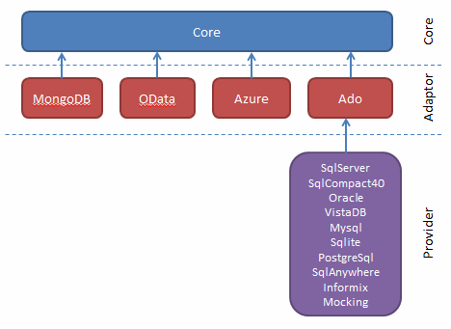
Dependencies & Architecture

Slide 9
How to start?
PM> Install-Package Simple.Data.SqlServer

Slide 10
Connection
Open default from .config
<configuration>
<connectionStrings>
<add name="Simple.Data.Properties.Settings.DefaultConnectionString"
connectionString="--Your connection string--" />
</connectionStrings>
</configuration>
var db = Database.Open();

Slide 11
Connection
Open named from .config
<configuration>
<connectionStrings>
<add name="MyCustomConnectionString"
connectionString="--Your connection string--" />
</connectionStrings>
</configuration>
var db = Database.OpenNamedConnection("MyCustomConnectionString");

Slide 12
Connection
Pass connection string
Open from file
var db = Database.OpenConnection("--Your connection string--");
var db = Database.OpenFile("--.sdf file path--");

Slide 13
Connection
More than one provider?
Provider string:
var db = Database.OpenConnection("connection string", "provider string");

Slide 14
Connection
Provider | String To Use
Simple.Data.SqlServer | System.Data.SqlServer
Simple.Data.SqlCe35 | sdf
Simple.Data.SqlCe40 | System.Data.SqlServerCe System.Data.SqlServerCe.4.0
Simple.Data.MySql | MySql.Data.MySqlClient
Simple.Data.Oracle | Oracle.DataAccess.Client Devart.Data.Oracle
Simple.Data.Sqlite | db sqlite
Simple.Data.SqlAnywhere | iAnywhere.Data.SqlAnywhere
Simple.Data.PostgreSql | Npgsql
Simple.Data.Access | mdb accdb System.Data.OleDb

Slide 15
Connection
Basic connection flow:
Provider string:
private int Execute(ICommandBuilder commandBuilder, IDbConnection connection)
{
using (connection.MaybeDisposable())
{
using (IDbCommand command = commandBuilder.GetCommand())
{
connection.OpenIfClosed();
return command.TryExecuteNonQuery();
}
}
}

Slide 16
Connection
Shared connection:
Provider string:
var db = Database.OpenConnection(connectionString);
SqlConnection conn = new SqlConnection(connectionString);
conn.Open();
db.UseSharedConnection(conn);
//Do stuff here
db.StopUsingSharedConnection();
conn.Close();

Slide 17
Give me data!

Slide 18
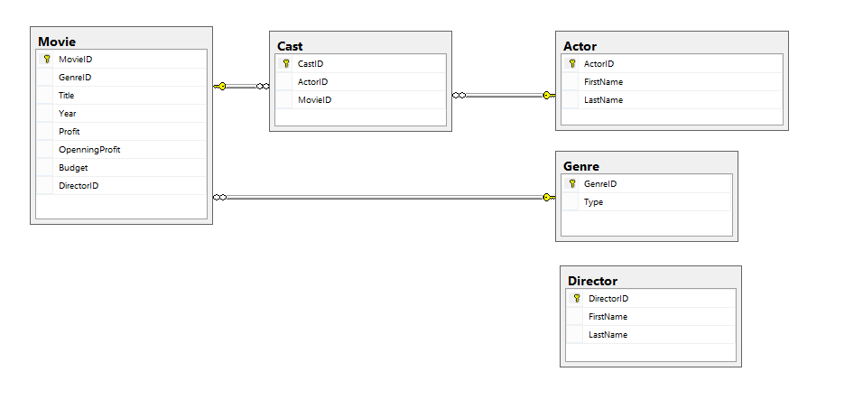
Give me data!
Database schema:

Slide 19
Naming Convention
db.dbo.Movies.FindAllByGenreId(3)
?
SELECT * FROM dbo.Movie WHERE GenreId = 3

Slide 20
Naming Convention
db.dbo.Movies.FindAllByGenreId(3)
DynamicSchema
DynamicTable
Command
Column

Slide 21
Naming Convention
db.dbo.Movies.FindAllByGenreId(3)
Homogenized: ("[^a-z0-9]")
private static string HomogenizeImpl(string source)
{
return string.Intern(
_homogenizeRegex.Replace(source.ToLowerInvariant(), string.Empty));
}

Slide 22
Naming Convention
db.dbo.Movies.FindAllByGenreId(3)
Pluralized:
var table = FindTableWithName(tableName.Homogenize())
?? FindTableWithPluralName(tableName.Homogenize())
?? FindTableWithSingularName(tableName.Homogenize());

Slide 23
Naming Convention
db.Movies
db.Movie
db.movies
db._M_oV_iEs
db.dbo.Movie
db.notExistingSchema.Movie
db.dbo["Movie"]
= dbo.movie

Slide 24
Naming Convention
Fluid
Indexer
Mixed
db.dbo.Movies.FindAllByGenreId(3);
db["dbo"]["Movies"].FindAllByGenreId(3);
db.dbo["Movies"].FindAllByGenreId(3);
db["dbo"].Movies.FindAllByGenreId(3);

Slide 25
Give me data!
SimpleRecord
SimpleQuery

Slide 26
SimpleRecord
Get
Find

Slide 27
SimpleRecord
public SimpleRecord Get( object[] primaryKeyValues )
var movie = db.Movies.Get(3);
SELECT TOP 1
[dbo].[Movie].[MovieID], [dbo].[Movie].[GenreID], [dbo].[Movie].[Title], [dbo].[Movie].[Year], [dbo].[Movie].[Profit], [dbo].[Movie].[OpenningProfit], [dbo].[Movie].[Budget], [dbo].[Movie].[DirectorID]
from [dbo].[Movie]
where [MovieID] = @p1
Parameters: @p1 (Int32) = 3

Slide 28
SimpleRecord
public SimpleRecord Find( SimpleExpression criteria )
var movie = db.Movies.Find(db.Movies.GenreId == 3);
select
[dbo].[Movie].[MovieID], [dbo].[Movie].[GenreID], [dbo].[Movie].[Title], [dbo].[Movie].[Year], [dbo].[Movie].[Profit], [dbo].[Movie].[OpenningProfit], [dbo].[Movie].[Budget], [dbo].[Movie].[DirectorID]
from [dbo].[Movie]
where [dbo].[Movie].[GenreID] = @p1
Parameters: @p1 (Int32) = 3

Slide 29
SimpleRecord
public SimpleRecord Find( SimpleExpression criteria )
var movie = db.Movies.Find(db.Movies.GenreId == 3);
DON’T USE IT
select
[dbo].[Movie].[MovieID], [dbo].[Movie].[GenreID], [dbo].[Movie].[Title], [dbo].[Movie].[Year], [dbo].[Movie].[Profit], [dbo].[Movie].[OpenningProfit], [dbo].[Movie].[Budget], [dbo].[Movie].[DirectorID]
from [dbo].[Movie]
where [dbo].[Movie].[GenreID] = @p1
Parameters: @p1 (Int32) = 3

Slide 30
SimpleQuery
All
FindAll
FindAllBy*

Slide 31
SimpleQuery
public SimpleQuery All( SimpleExpression criteria )
var movies = db.Movies.All();
select
[dbo].[Movie].[MovieID],[dbo].[Movie].[GenreID],[dbo].[Movie].[Title],
[dbo].[Movie].[Year],[dbo].[Movie].[Profit],[dbo].[Movie].[OpenningProfit],
[dbo].[Movie].[Budget],[dbo].[Movie].[DirectorID]
from [dbo].[Movie]

Slide 32
SimpleQuery
public SimpleQuery FindAll( SimpleExpression criteria )
var movies = db.Movies.FindAll(db.Movies.GenreId == 3);
select
[dbo].[Movie].[MovieID],[dbo].[Movie].[GenreID],[dbo].[Movie].[Title],
[dbo].[Movie].[Year],[dbo].[Movie].[Profit],[dbo].[Movie].[OpenningProfit],
[dbo].[Movie].[Budget],[dbo].[Movie].[DirectorID]
from [dbo].[Movie]
WHERE [dbo].[Movie].[GenreID] = @p1
Parameters: @p1 (Int32) = 3

Slide 33
SimpleQuery
public SimpleQuery FindAll( SimpleExpression criteria )
var movies = db.Movies.FindAll(db.Movies.GenreId == 3);
var movies = db.Movies.FindAll(db.Movies.GenreId == 3
&& db.Movies.Year < new DateTime(2014, 01, 01));
var movies = db.Movies.FindAll(db.Movies.GenreId == 3
|| db.Movies.Year < new DateTime(2014, 01, 01));

Slide 34
SimpleQuery
public SimpleQuery FindAllBy( Object[] filterExpressions )
public SimpleQuery FindAllBycolumnName1[AndcolumnName2…] ( Object columnValue1 [, Object columnValue2] )
var movies = db.Movies.FindAllByGenreId(3);
var movies = db.Movies.FindAllBy(GenreId: 3);
select
[dbo].[Movie].[MovieID],[dbo].[Movie].[GenreID],[dbo].[Movie].[Title],
[dbo].[Movie].[Year],[dbo].[Movie].[Profit],[dbo].[Movie].[OpenningProfit],
[dbo].[Movie].[Budget],[dbo].[Movie].[DirectorID]
from [dbo].[Movie]
WHERE [dbo].[Movie].[GenreID] = @p1
Parameters: @p1 (Int32) = 3

Slide 35
SimpleQuery
public SimpleQuery FindAllBy( Object[] filterExpressions )
public SimpleQuery FindAllBycolumnName1[AndcolumnName2…] ( Object columnValue1 [, Object columnValue2] )
var movies = db.Movies.FindAllByGenreId(3);
var movies = db.Movies.FindAllBy(GenreId: 3);
var movies = db.Movies.FindAllByGenreIdAndTitle(3, "Django Unchained");
var movies = db.Movies.FindAllBy(GenreId: 3, Title: "Django Unchained");

Slide 36
Query Modifiers
Select, As
Where, (In, Between, Like, NotLike)
Distinct
OrderBy, ThenBy
First, FirstOrDefault, Single, SingleOrDefault

Slide 37
Query Modifiers
public SimpleQuery Select(params SimpleReference[] columns)
Select:
var movies = db.Movies.All().Select(db.Movies.Title, db.Movies.Profit);
select
[dbo].[Movie].[Title],[dbo].[Movie].[Profit]
from [dbo].[Movie]

Slide 38
Query Modifiers
public ObjectReference As(string alias)
Select with Alias:
var movies = db.Movies.All().Select(db.Movies.Title, db.Movies.Profit,
(db.Movies.Profit-db.Movies.Budget).As("Balance"));
select
[dbo].[Movie].[Title],
[dbo].[Movie].[Profit],
([dbo].[Movie].[Profit] - [dbo].[Movie].[Budget]) AS [Balance]
from [dbo].[Movie]

Slide 39
Query Modifiers
public AllColumnsSpecialReference Star()
Select *
var movies = db.Movies.All().Select(db.Movies.Star());
var movies = db.Movies.All().Select(db.Movies.AllColumns());
select * from [dbo].[Movie]

Slide 40
Query Modifiers
public WhereClause(SimpleExpression criteria)
Where:
var movies = db.Movies.All()
.Select(db.Movies.Title, db.Movies.Profit)
.Where(db.Movies.Profit > 500);
select
[dbo].[Movie].[Title],
[dbo].[Movie].[Profit]
from [dbo].[Movie]
WHERE [dbo].[Movie].[Profit] > @p1
Parameters: @p1 (Decimal) = 500

Slide 41
Query Modifiers
Combined Where:
var movies = db.Movies.All()
.Select(db.Movies.Title, db.Movies.Profit)
.Where(db.Movies.Profit > 500 && db.Movies.Year > new DateTime(2014, 1, 1));
var movies = db.Movies.All()
.Select(db.Movies.Title, db.Movies.Profit)
.Where(db.Movies.Profit > 500)
.Where(db.Movies.Year > new DateTime(2014, 1, 1));

Slide 42
Query Modifiers
Where: In, Not In
var movies = db.Movies.All()
.Select(db.Movies.Title, db.Movies.Profit)
.Where(db.Movies.GenreId == new[] { 1, 4, 5 });
var movies = db.Movies.All()
.Select(db.Movies.Title, db.Movies.Profit)
.Where(db.Movies.GenreId != new[] { 1, 4, 5 });

Slide 43
Query Modifiers
Where: Between, Not Between
var movies = db.Movies.All()
.Select(db.Movies.Title, db.Movies.Profit)
.Where(db.Movies.Profit == 300.to(500));
var movies = db.Movies.All()
.Select(db.Movies.Title, db.Movies.Profit)
.Where(db.Movies.Profit != 300.to(500));

Slide 44
Query Modifiers
Where: Like, Not Like
var movies = db.Movies.All()
.Select(db.Movies.Title, db.Movies.Profit)
.Where(db.Movies.Title.Like("%Django%"));
var movies = db.Movies.All()
.Select(db.Movies.Title, db.Movies.Profit)
.Where(db.Movies.Title.NotLike("%Django%"));

Slide 45
Query Modifiers
public OrderByClause(ObjectReference reference, OrderByDirection? dir = null)
OrderBy:
OrderBy Descending:
Combined OrderBy (ThenBy - alternatively):
var movies = db.Movies.All().OrderBy(db.Movies.Title);
var movies = db.Movies.All().OrderByTitle();
var movies = db.Movies.All().OrderByDescending(db.Movies.Title);
var movies = db.Movies.All().OrderByTitleDescending();
var movies = db.Movies.All().OrderByTitle().OrderByGenreId();

Slide 46
Join
Explicit Join
Implicit „Natural” Join

Slide 47
Explicit Join
Syntax:
var results = db.Movies.All()
.Join(db.Genre).On(db.Genre.GenreId == db.Movies.GenreId)
.Select(db.Movies.Title, db.Genre.Type);
var results = db.Movies.All()
.Join(db.Genre).On(GenreId: db.Movies.GenreId)
.Select(db.Movies.Title, db.Genre.Type);
var results = db.Movies.All()
.Join(db.Genre, GenreId: db.Movies.GenreId)
.Select(db.Movies.Title, db.Genre.Type);

Slide 48
Explicit Join
RESULT:
select
[dbo].[Movie].[Title],
[dbo].[Genre].[Type]
from [dbo].[Movie]
JOIN [dbo].[Genre] ON ([dbo].[Genre].[GenreID] = [dbo].[Movie].[GenreID])

Slide 49
Explicit Join
Syntax with alias:
dynamic genreAlias;
var results = db.Movies.All()
.Join(db.Genre.As("g"), out genreAlias)
.On(genreAlias.GenreId == db.Movies.GenreId)
.Select(db.Movies.Title, genreAlias.Type);

Slide 50
Explicit Join
Complex example:
var results = db.Movies.All()
.Join(db.Cast).On(db.Cast.MovieId == db.Movies.MovieId)
.Join(db.Actor).On(db.Cast.ActorId == db.Actor.ActorId)
.Select(db.Movies.Title, db.Actor.FirstName, db.Actor.LastName)
.Where(db.Actor.FirstName.Like("%Mat%"));

Slide 51
Natural Join
Chain of tables:
db.StartTable.Table2.Table3 …. TableN.Column;

Slide 52
Natural Join
Explicit join:
Natural join:
var results = db.Movies.All()
.Join(db.Genre, GenreId: db.Movies.GenreId)
.Select(db.Movies.Title, db.Genre.Type);
var results = db.Movies.All().Select(db.Movies.Title, db.Movies.Genre.Type);

Slide 53
Natural Join
Complex explicit join:
Simple natural join:
var results = db.Movies.All()
.Join(db.Cast).On(db.Cast.MovieId == db.Movies.MovieId)
.Join(db.Actor).On(db.Cast.ActorId == db.Actor.ActorId)
.Select(db.Movies.Title, db.Actor.FirstName, db.Actor.LastName)
.Where(db.Actor.FirstName.Like("%Mat%"));
var results = db.Movies.All()
.Select(db.Movies.Title, db.Movies.Cast.Actor.FirstName, db.Movies.Cast.Actor.LastName)
.Where(db.Actor.FirstName.Like("%Mat%"));

Slide 54
Aggregation Functions
Min, Max, Sum, Avg, Count, CountDistinct
Having

Slide 55
Aggregation Functions
Min, Max, Sum, Avg, Count, CountDistinct
var results = db.Actor.All()
.Select(db.Actor.FirstName, db.Actor.LastName,
db.Actor.Cast.MovieId.Count().As("NumberOfMovies"));
select
[dbo].[Actor].[FirstName],
[dbo].[Actor].[LastName],
Count([dbo].[Cast].[MovieID]) AS [NumberOfMovies]
from [dbo].[Actor]
LEFT JOIN [dbo].[Cast] ON ([dbo].[Actor].[ActorID] = [dbo].[Cast].[ActorID])
GROUP BY [dbo].[Actor].[FirstName],[dbo].[Actor].[LastName]

Slide 56
Aggregation Functions
Having
var results = db.Actor.All()
.Having(db.Actor.Cast.Movie.Profit.Min() > 200);
select *
from [dbo].[Actor]
JOIN [dbo].[Cast] ON ([dbo].[Actor].[ActorID] = [dbo].[Cast].[ActorID])
JOIN [dbo].[Movie] ON ([dbo].[Movie].[MovieID] = [dbo].[Cast].[MovieID])
GROUP BY [dbo].[Actor].[ActorID],[dbo].[Actor].[FirstName],[dbo].[Actor].[LastName]
HAVING Min([dbo].[Movie].[Profit]) > @p1
Parameters: @p1 (Int32) = 300

Slide 57
Evaluation Strategies
Lazy loading
Eager loading

Slide 58
Lazy Loading
var lazyMovie = db.Movie.Get(1);
Display.Result(lazyMovie.MovieId, lazyMovie.Title);
foreach (var actor in lazyMovie.Cast.Actor)
{
Display.Result(actor.FirstName, actor.LastName);
}

Slide 59
Lazy Loading
var lazyMovie = db.Movie.Get(1);
Display.Result(lazyMovie.MovieId, lazyMovie.Title);
foreach (var actor in lazyMovie.Cast.Actor)
{
Display.Result(actor.FirstName, actor.LastName);
}
SELECT TOP 1 *
from [dbo].[Movie] where [MovieID] = @p1
Parameters: @p1 (Int32) = 1

Slide 60
Lazy Loading
var lazyMovie = db.Movie.Get(1);
Display.Result(lazyMovie.MovieId, lazyMovie.Title);
foreach (var actor in lazyMovie.Cast.Actor)
{
Display.Result(actor.FirstName, actor.LastName);
}
select *
from [dbo].[Actor]
JOIN [dbo].[Cast] ON ([dbo].[Actor].[ActorID] = [dbo].[Cast].[ActorID])
WHERE [dbo].[Cast].[MovieID] = @p1
Parameters: @p1 (Int32) = 1

Slide 61
Eager Loading
var eagerMovie = db.Movie.With(db.Movie.Cast.Actor.As("Actors")).Get(1);
Display.Result(eagerMovie.MovieId, eagerMovie.Title);
foreach (var actor in eagerMovie.Actors)
{
Display.Result(actor.FirstName, actor.LastName);
}

Slide 62
Eager Loading
var eagerMovie = db.Movie.With(db.Movie.Cast.Actor.As("Actors")).Get(1);
Display.Result(eagerMovie.MovieId, eagerMovie.Title);
foreach (var actor in eagerMovie.Actors)
{
Display.Result(actor.FirstName, actor.LastName);
}

Slide 63
Eager Loading
WITH __Data
AS
(SELECT [dbo].[Movie].[MovieID], ROW_NUMBER() OVER(ORDER BY dbo].[Movie].[MovieID]) AS [_#_]
from [dbo].[Movie] WHERE [dbo].[Movie].[MovieID] = @p1)
SELECT [dbo].[Movie].[MovieID],[dbo].[Movie].[GenreID],[dbo].[Movie].[Title],[dbo].[Movie].[Year],[dbo].[Movie].[Profit],[dbo].[Movie].[OpenningProfit],[dbo].[Movie].[Budget],[dbo].[Movie].[DirectorID],
[Actors].[ActorID] AS [__withn__Actors__ActorID],
[Actors].[FirstName] AS [__withn__Actors__FirstName],
[Actors].[LastName] AS [__withn__Actors__LastName]
FROM __Data JOIN [dbo].[Movie] ON [dbo].[Movie].[MovieID] = __Data.[MovieID] LEFT JOIN [dbo].[Cast] ON ([dbo].[Movie].[MovieID] = [dbo].[Cast].[MovieID]) LEFT JOIN [dbo].[Actor] [Actors] ON ([Actors].[ActorID] = [dbo].[Cast].[ActorID]) WHERE [dbo].[Movie].[MovieID] = @p1 AND [_#_] BETWEEN 1 AND 1
Parameters:
@p1 (Int32) = 1

Slide 64
Eager Loading
public WithClause(ObjectReference objectReference)
With (for simple relation)
With (for longer chain of relations)
var result = db.Movie.WithGenre().Get(1);
var result = db.Movie.With(db.Movie.Genre).Get(1);
var result = db.Movie.With(db.Movie.Cast.Actor).Get(1);

Slide 65
Eager Loading
WithOne, WithMany (for relations without foreign key):
How to get „with” values:
dynamic directorAlias;
var result = db.Movie
.WithGenre()
.With(db.Movie.Cast.Actor.As("Actors"))
.Join(db.Director, out directorAlias)
.On(directorAlias.DirectorID == db.Movie.DirectorID)
.WithOne(directorAlias).Get(1);
Display.Result(eagerMovie.Title,
eagerMovie.Genre.Type,
eagerMovie.Director.FirstName,
eagerMovie.Director.LastName);

Slide 66
Casting
Implicit „Magic” Casting
Explicit Casting

Slide 67
Implicit „Magic” Casting
var actor = db.Actor.Get(1);
Create Class
public class Actor
{
public int ActorId { get; set; }
public string FirstName { get; set; }
public string LastName { get; set; }
}
Cast a spell
Actor actor = db.Actor.Get(1);

Slide 68
Implicit SimpleRecord Casting
When No records:
result: null
When wrong Type:
result: new NotAnActor()
Actor actor = db.Actor.Get(-1);
NotAnActor actor = db.Actor.Get(1);

Slide 69
Implicit SimpleQuery Casting
SimpleQuery can be casted to IEnumerable<>, List<>, Array<>
List<Actor> actors = db.Actor.All();

Slide 70
Implicit SimpleQuery Casting
When No records:
result: empty list
When wrong Type:
result: full collection of new NotAnActor()
List<Actor> actors = db.Actor.FindAll(db.Actor.ActorId == -1);
List<NotAnActor> actors = db.Actor.FindAll();

